Slide 1
Alpha
Insights
Data Science for
Business

Slide 2
Table of Contents
01
02
03
04
Techs Stack
and Fundamentation
Validation Data
to clean or not to clean?
Pipeline Automation
Web &
Documentation

Slide 3
01
Techs
Stack

Slide 4
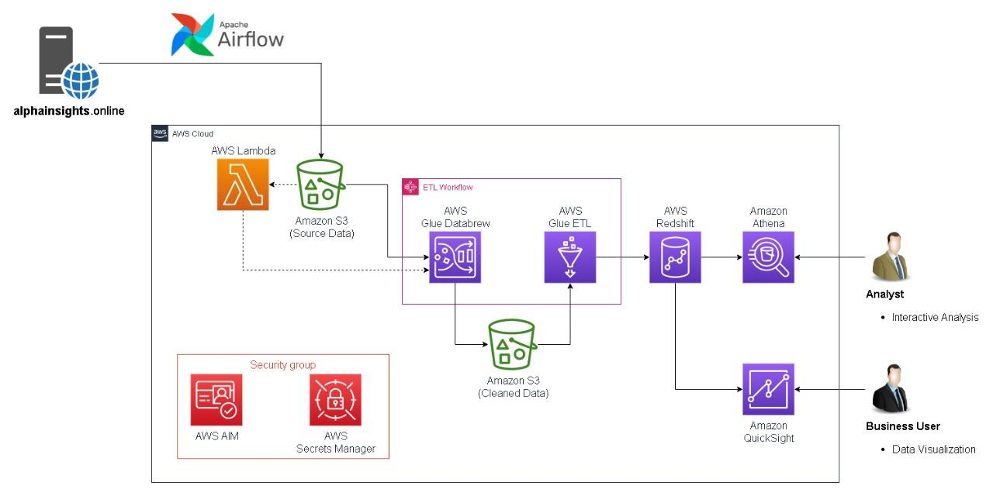
AWS ECOSYSTEM
Low Latency
More mature ecosystem
Scalability
Broader range of services
Security
Notes:
We’ve decided to go with the AWS service because it has these advantages over the rest:

Slide 5
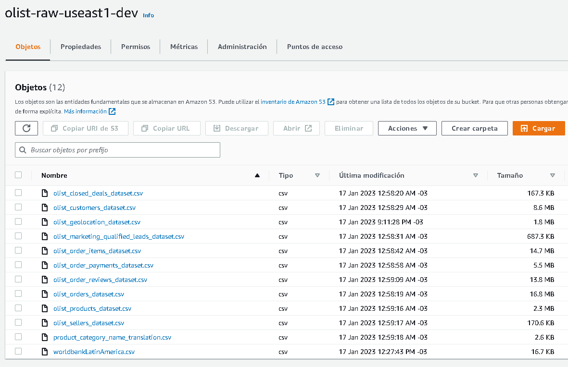
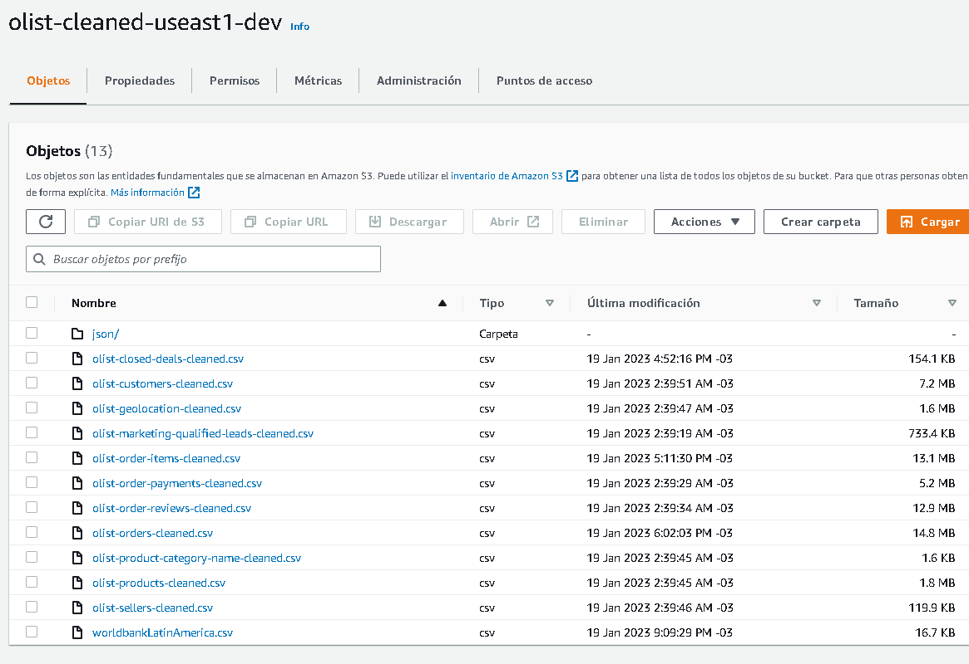
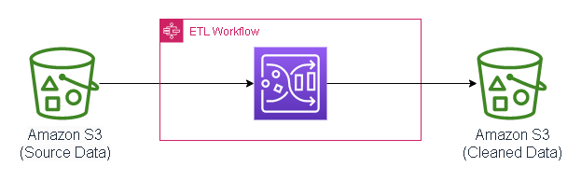
AWS S3
Notes:
Scalability: Can store and retrieve any amount of data, at any time, from anywhere on the web.
High durability: Data is stored across multiple devices in multiple facilities and automatically replicated to help protect against data loss.
High availability: Designed to provide 99.999999999% durability and 99.99% availability of objects over a given year.
Security: Provides multiple mechanisms to secure data such as encryption, access control and VPC endpoints.
Cost-effective: Pay only for the storage you use with no upfront or minimum costs.
Global Access: S3 is available in multiple regions and Edge locations, which enables you to store and retrieve data with low latency and high throughput.

Slide 6
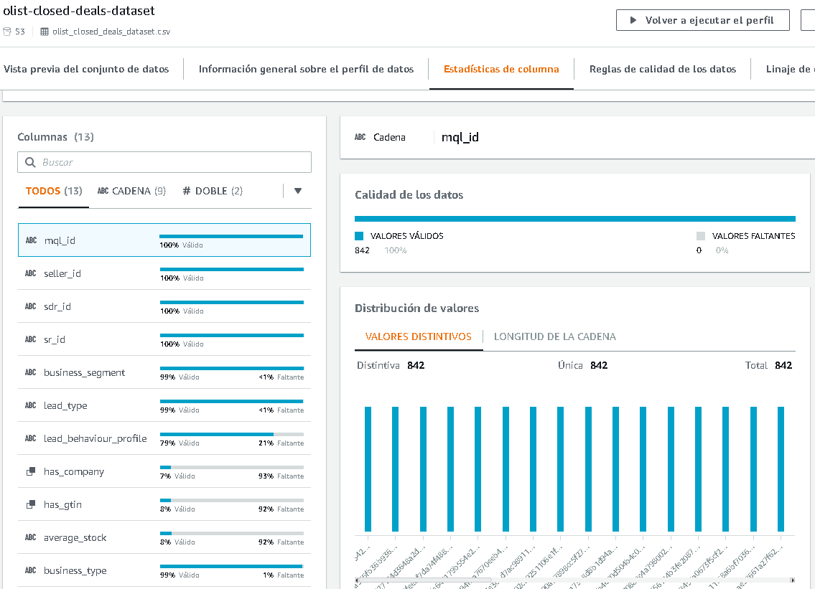
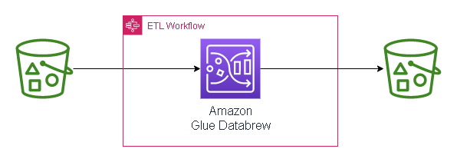
AWS GLUE DATABREW
Notes:
Automated data discovery: Glue Crawlers automatically discover and catalog data stored in data stores, including structured and semi-structured data.
ETL job authoring: Glue ETL jobs can be easily authored using Python or Scala, with prebuilt connectors for popular data stores.
Serverless execution: Glue ETL jobs can be triggered on a schedule or based on an event, and automatically scale based on the data volume, which eliminates the need to provision and manage servers.
Cost-effective: Pay only for the data processed by Glue ETL jobs, with no upfront or minimum costs.
Security: Glue provide multiple security mechanisms such as encryption, access control and VPC endpoints, making it easy to protect data and comply with regulatory requirements.
Flexibility: Glue supports data transformation using built-in transforms, custom code, and integration with Apache Spark and other popular open-source libraries.

Slide 7
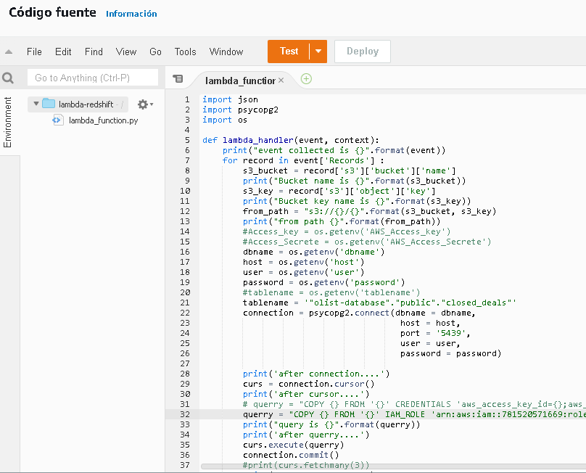
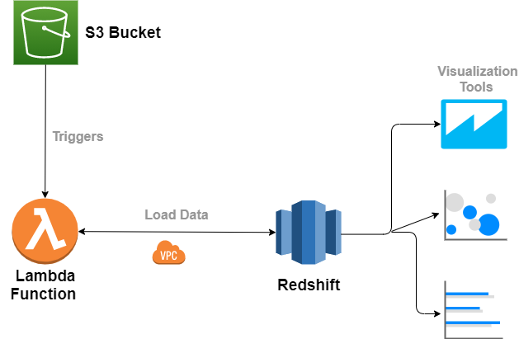
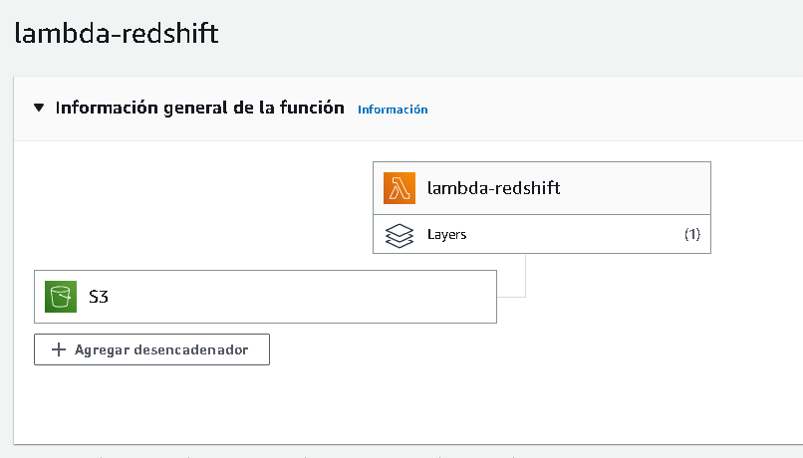
LAMBDA FUNCTION
Incremental Load
Notes:
Cost-effective: Only pay for the compute time used, rather than paying for a server to run 24/7.
Scalability: Automatically scales to handle incoming requests without the need for manual intervention.
Flexibility: Can be triggered by various AWS services such as S3, DynamoDB, and SNS.
Easy deployment: Can be easily deployed and updated through AWS CLI or AWS Lambda console.
High availability: Built-in redundancy and automatic failover for increased availability.
Event-driven: AWS Lambda is well suited for event-driven architectures, which can help simplify the overall design of your application.

Slide 8
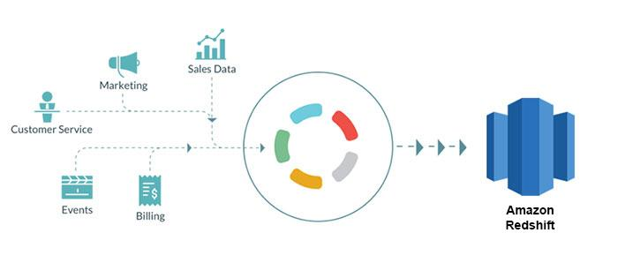
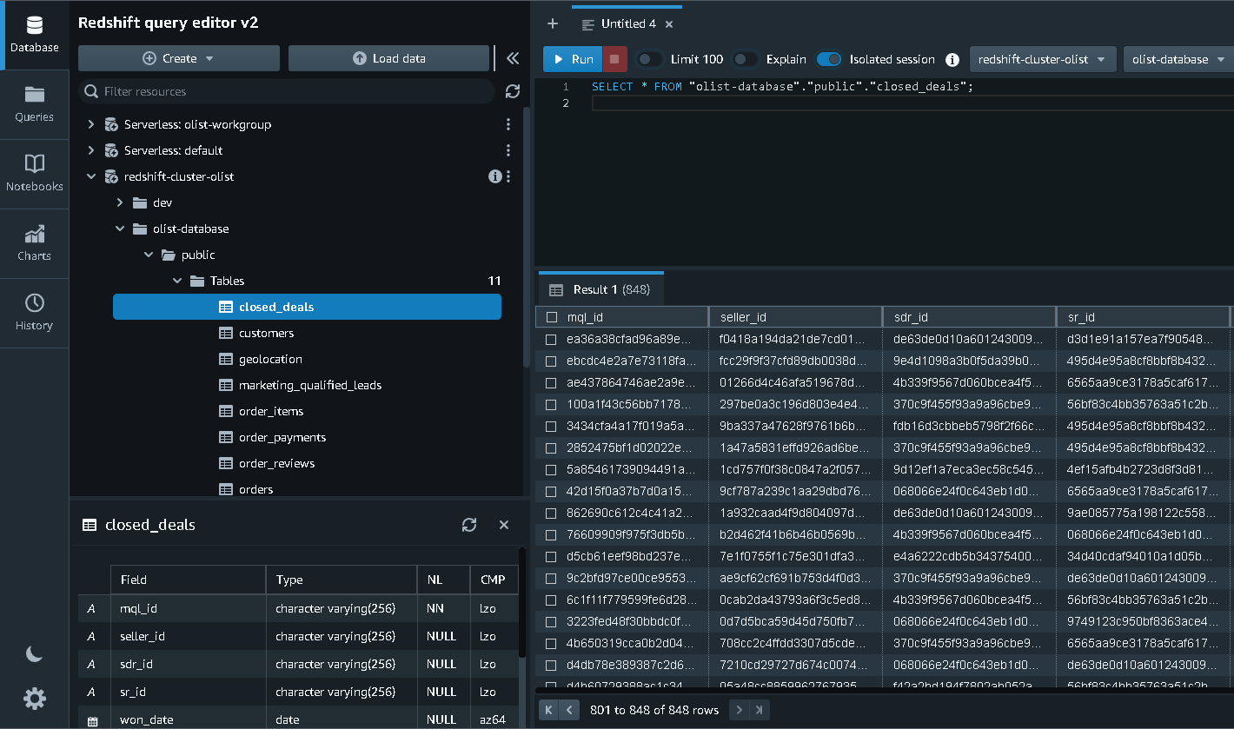
AWS REDSHIFT
Notes:
Scalability: Redshift can handle petabyte-scale data warehouses, and allows you to easily scale up or down by adding or removing nodes.
Performance: Redshift uses columnar storage, advanced compression, and parallel processing to deliver fast query performance.
Management: Redshift provides a simple management console, which makes it easy to monitor, maintain, and scale your data warehouse.
Analytical: Redshift is optimized for analytics and can handle complex analytical queries and reporting workloads, which makes it a great option for data warehousing and business intelligence (BI) workloads.

Slide 9
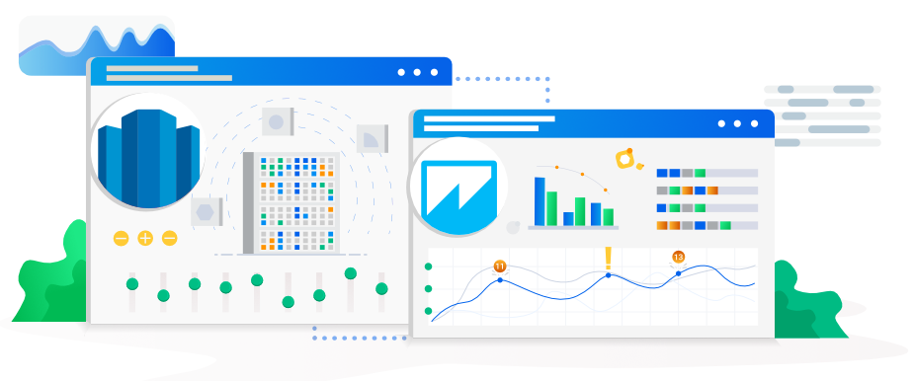
AWS QUICKSIGHT
Notes:
Easy to use: QuickSight has a user-friendly interface that makes it easy for non-technical users to create and share visualizations.
Fast performance: QuickSight uses a technology called SPICE (Super-fast, Parallel, In-memory Calculation Engine) to process and analyze data quickly.
Low cost: QuickSight is a pay-per-session service, which means users only pay for the resources they use.
Integration with other AWS services: QuickSight can be easily integrated with other AWS services such as S3, Redshift, and RDS to allow for seamless data analysis and visualization.
Collaboration: QuickSight allows multiple users to collaborate on the same visualization or dashboard, making it easy for teams to work together.

Slide 10




Slide 11
02
Validation
Data

Slide 12
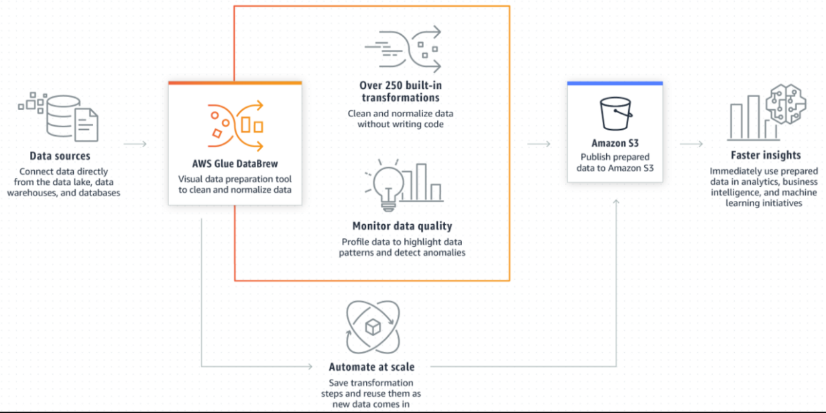
AWS GLUE DATABREW
Getting the data cleaned

Slide 13
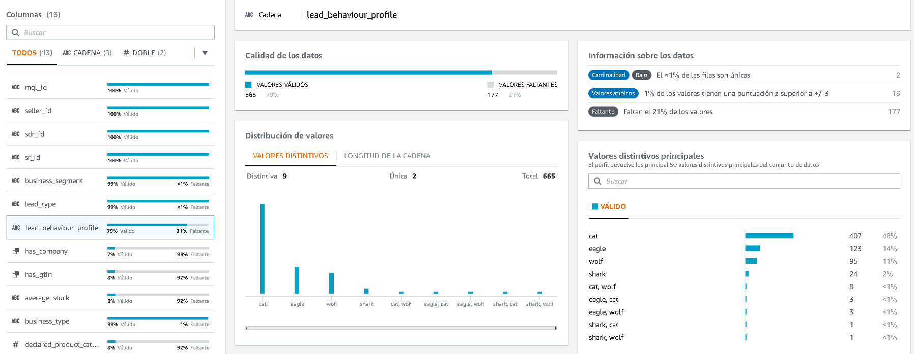
EVALUATE
DATA QUALITY

Slide 14
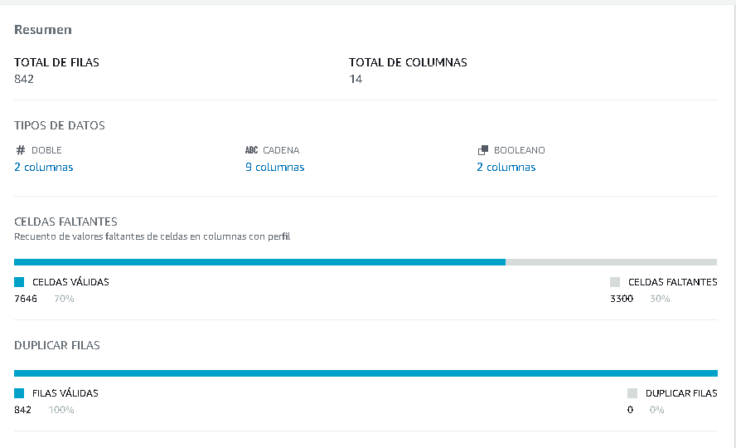
REPLACING
MISSING VALUES

Slide 15
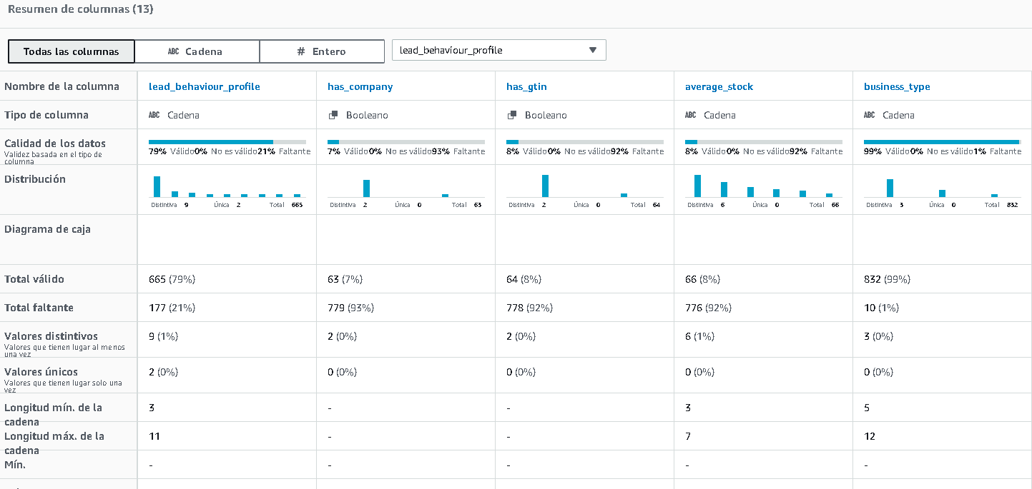
REMOVING COLUMNS

Slide 16
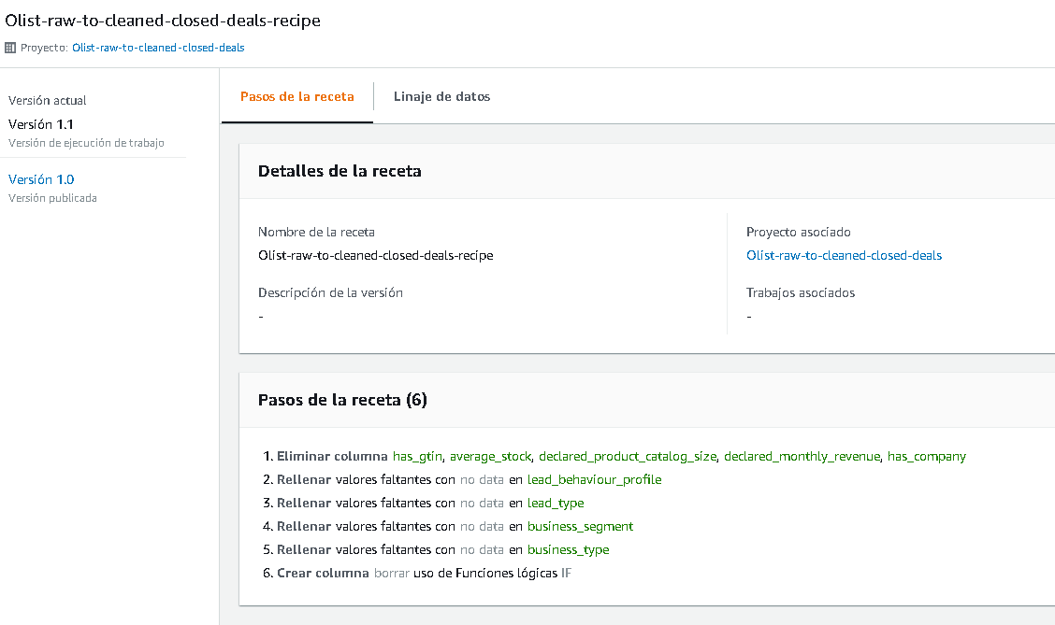
PIPELINE

Slide 17
03 Pipeline
Automation

Slide 18
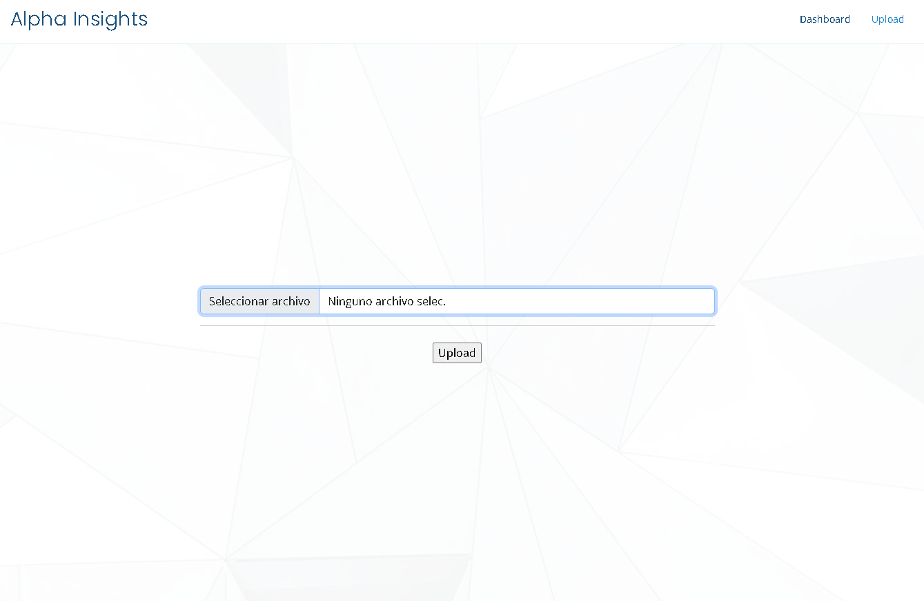
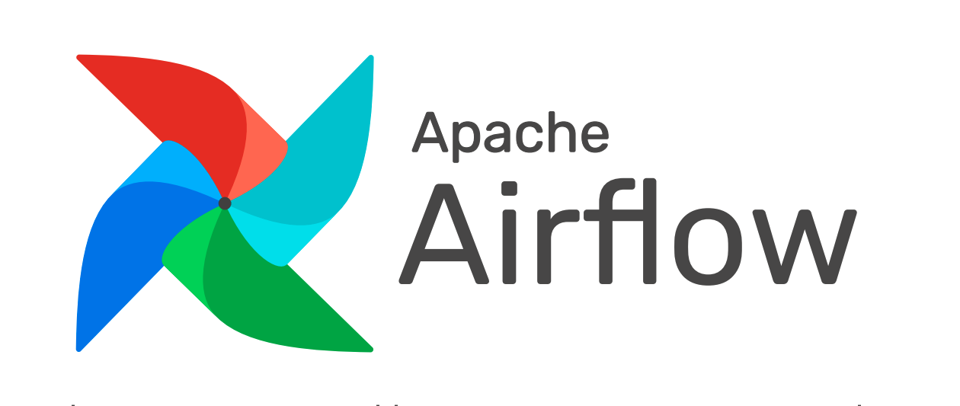
Notes:
In this case we use 2 particular techs, that are airflow and lambda function from AWS.
Then Olist can upload on its own the files it wants to upload incrementally, and every day at midnight it will execute the next Airflow DAG

Slide 19
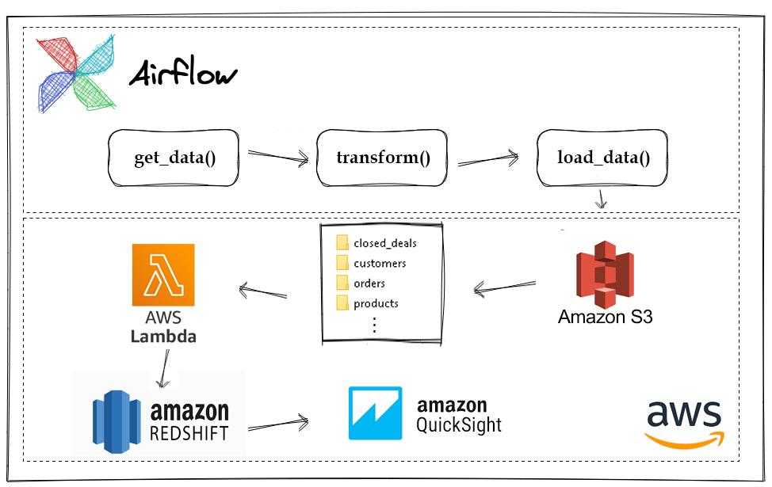
Notes:
The airflow DAG in python consist in three functions :
The first function get_data() get the data from the website using the requests library
The next step would be to transform this data with transform function. Depending on the name of the file, it will be saved in a specific folder of the incremental load bucket
The final step would be to load this data in the AWS S3 bucket and for that, we would be using the boto3 library in python. We would also need the AWS access and secret keys
So, again in AWS we use the lambda function to listen to the bucket, as soon as a file enters, the corresponding function is executed where it will store it already clean in redshift to later be able to see the corresponding graphs in quicksight
It should be noted that this is not yet implemented, since at first we had chosen to use the AWS API Gateway, but we finally discarded that idea, but we lost important development time

Slide 20
04
Documentation

Slide 21
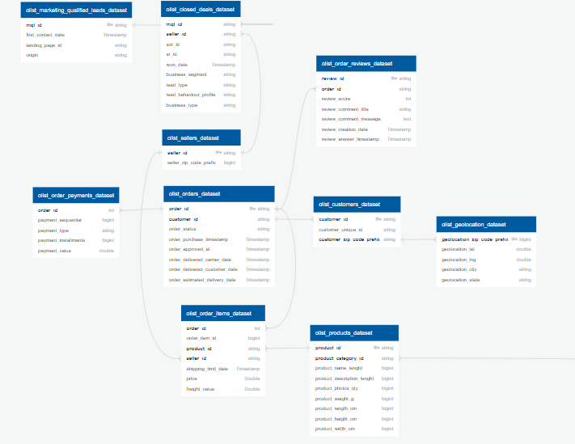
Entity Relationship Diagram

Slide 22
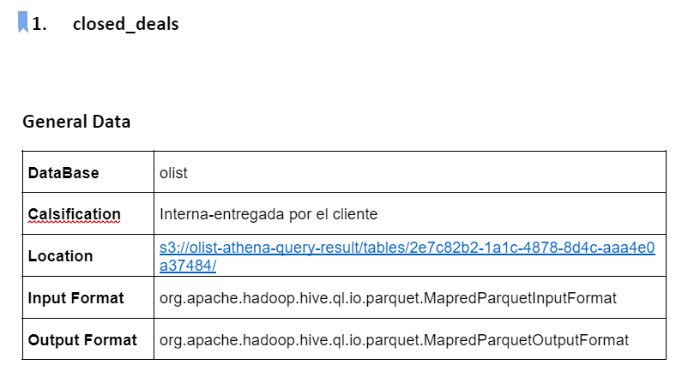
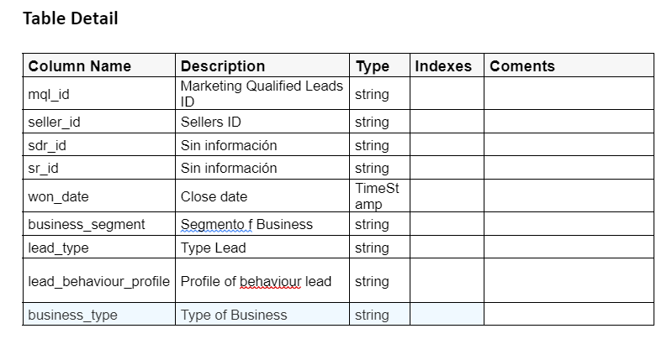
Data Dictionary
A document with the following format is provided.

Slide 23
Thanks!
Do you have any questions?
contact@alphainsights.com
+55 5589 55488 55
www.alphainsights.online

